Slide 1

How to interview prep for success
Notes:
Hi everyone! My name is Michael Greaves and today I am going to talk to you about how to interview prep for success.
Given the current climate of the world right now, it is certainly more challenging to perform job searches and start building your career. However, this is an excellent time and opportunity to build and develop your current skillset and prepare for many of the future interviews to come your way.

Slide 2
The average number of people who apply for any given job: 118. Twenty-percent of those applicants get an interview.
WHAT DOES THIS MEAN?
Notes:
According to Forbes.com, “The average number of people who apply for any given job is 118. Twenty-percent of those applicants get an interview.”
What this means is that when you are selected as a highly qualified candidate for a specific position, it is also important that you show up equally prepared for your first direct interaction with the faces of the company. To do that it is important to interview prep properly. Utilizing your time to thoroughly assess your goals, qualifications, skills, and values relative to the position and potential employer.

Slide 3
WHAT DOES INTERVIEW PREP LOOK LIKE?
RESEARCH
+ REFLECTION
+ STORYTELLING
INTERVIEW PREP
Notes:
At the most basic level interview prep involves research, reflection, and storytelling to craft holistic answers to potential interview questions.

Slide 4
ACTIONABLE STEPS
EXAMINE THE JOB DESCRIPTION & CONSIDER WHY YOU ARE APPLYING
RESEARCH THE COMPANY AND ROLE
DEVELOP ANSWERS TO COMMON INTERVIEW QUESTIONS
PREPARE SEVERAL IN-DEPTH QUESTIONS FOR THE INTERVIEWERS
PRACTICE YOUR SPEAKING VOICE, BODY LANGUAGE, AND SELLING YOURSELF AND SKILLSET
Notes:
The actionable steps involve
Examining the Job Description and considering Why You Are applying
Researching the Company and Role
Developing answers to Common Interview Questions
Preparing Several In-Depth Questions for the Interviewers
And Practicing Your Speaking Voice, Body Language, and selling yourself and skillset

Slide 5
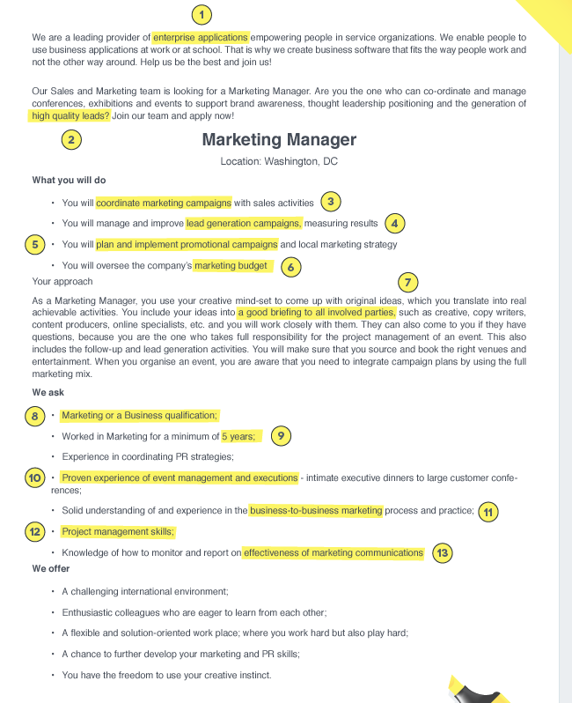
EXAMINE THE JOB DESCRIPTION & CONSIDER WHY YOU ARE APPLYING
JOB DESCRIPTION = GUIDE
QUALIFICATIONS
QUALITIES
BACKGROUND
Notes:
Examining the job description allows you to have a loose guide to the qualifications, qualities, and background that employers are searching for. By highlighting and and noting these important pieces, you can gain insight into the types of questions employers may ask as well assess your ability to satisfy and exceed these preferences.

Slide 6
RESEARCH THE COMPANY AND ROLE
Products or Services
Role or Related Positions
Company Culture
Recent Company News
Notes:
By researching the products, services, position, company culture, and recent company news you will not only be more equipped to answer questions but will show the employer how serious you are about the position at hand. Additionally, you will be able to understand the influence of your role within the company, understand if the environment is suitable for you to succeed, and determine if the position and company mission aligns with your personal goals and values.
Utilizing online resources such as LinkedIn, Glassdoor, Official company social media accounts, and respective websites are perfect examples to gain insight and develop a personal connection with the employer.

Slide 7
DEVELOP ANSWERS TO COMMON INTERVIEW QUESTIONS
TELL ME ABOUT YOURSELF
WHY DO YOU WANT TO WORK AT THIS COMPANY?
WHAT ARE YOUR STRENGTHS AND WEAKNESSES?
Notes:
Develop Answers to Common Interview Questions
There are a range of interview styles, however there are a set of common questions that most interviewers ask candidates
Preparing answers that tell a story to these common questions allow the employer to be entertained and hear how you offer value to their company. As well as personalizes your story
Don’t be afraid to write down your questions - it will help you remember and demonstrate you are serious about the position

Slide 8

PREPARE SEVERAL IN-DEPTH QUESTIONS FOR THE INTERVIEWERS
HOW DO YOU MEASURE SUCCESS FOR SOMEONE IN THIS POSITION?
WHAT OPPORTUNITIES DO YOU OFFER EMPLOYEES FOR DIVERSITY & INCLUSION?
ARE THERE OPPORTUNITIES FOR GROWTH OR MOVEMENT WITHIN THE COMPANY?
Notes:
Prepare Several In-Depth Questions for the Interviewers
A common mistake for many candidates is to not prepare thoughtful questions for the interviewer
This is an opportunity to learn more about the technicalities of the positions, challenges/difficulties the department is facing, or more about the company culture
So create a few questions that allow you to demonstrate your genuine interest and curiosity
Don’t be afraid to write down your questions - it will help you remember and demonstrate you are serious about the position

Slide 9

PRACTICE YOUR SPEAKING VOICE, BODY LANGUAGE, SELLING YOURSELF, AND YOUR SKILLS
STRONG CONFIDENT VOICE
OPEN AND INVITING BODY LANGUAGE
FIRM HAND SHAKE
Notes:
Practice Your Speaking Voice, Body Language, Selling Yourself, and Your Skills
When you have completed the previous steps, its time to rehearse and practice to be fully prepared for the interview
Practice speaking a strong confident voice, being friendly, and using open body language
Pay attention to your smile, handshake, and arm/hand positions You can participate in mock interviews with friends or family to ease anxiety

